Slide 1



The presentation will begin shortly.

Slide 2
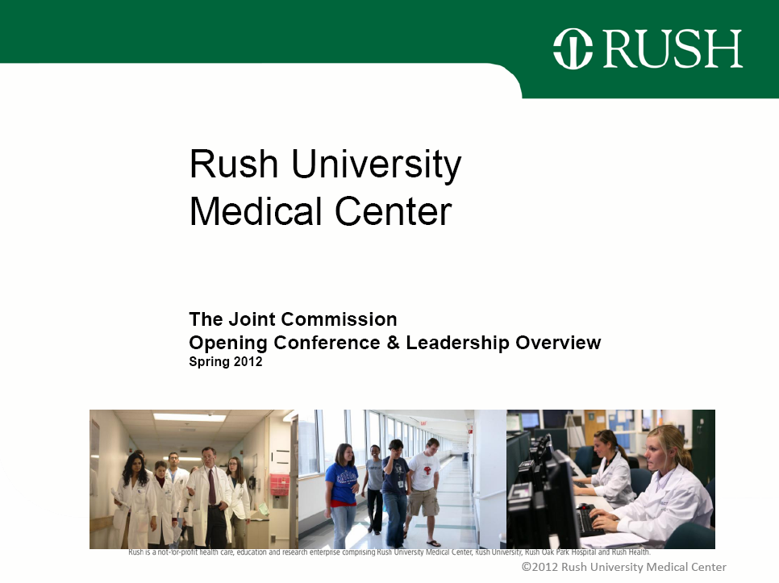

Diversity and Disparities Webinar
August 29, 2012
Sponsored by IFD and HRET

Slide 3
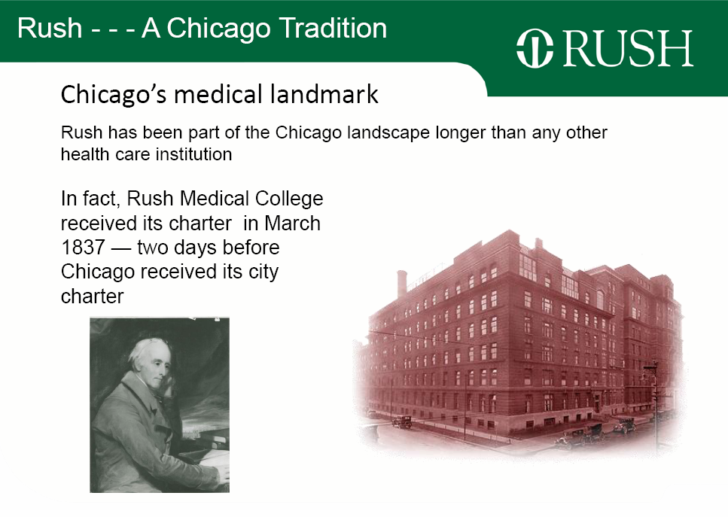

Slide 4
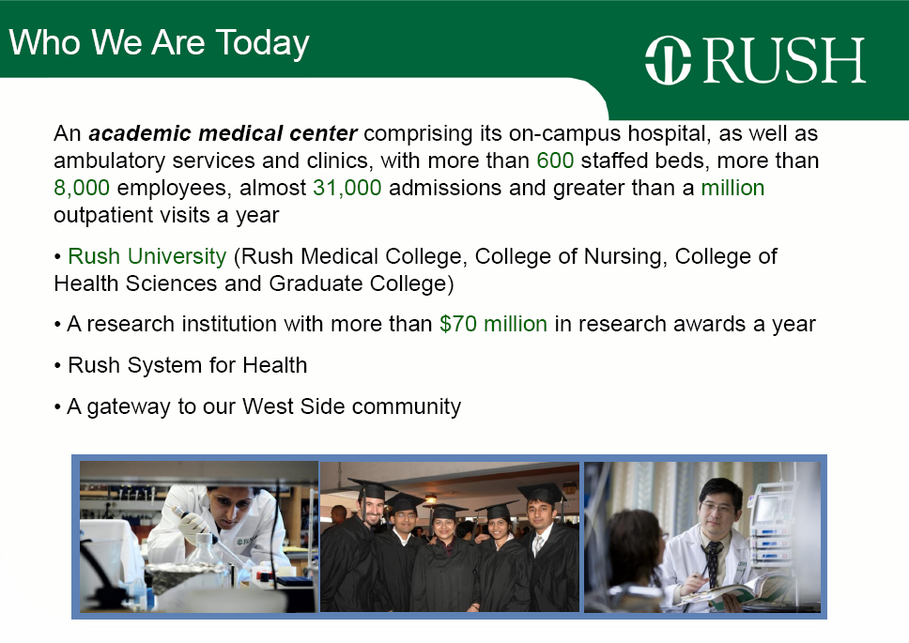

Slide 5
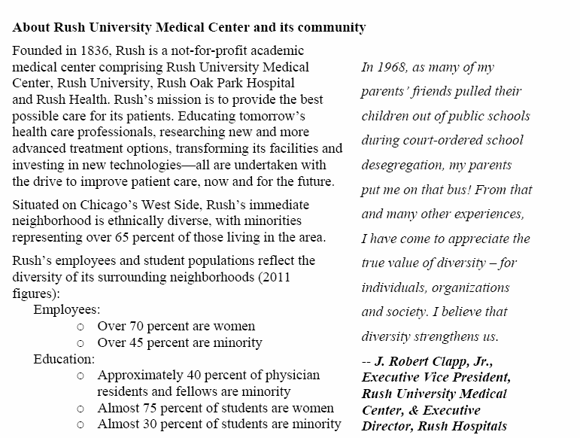

Slide 6


Slide 7
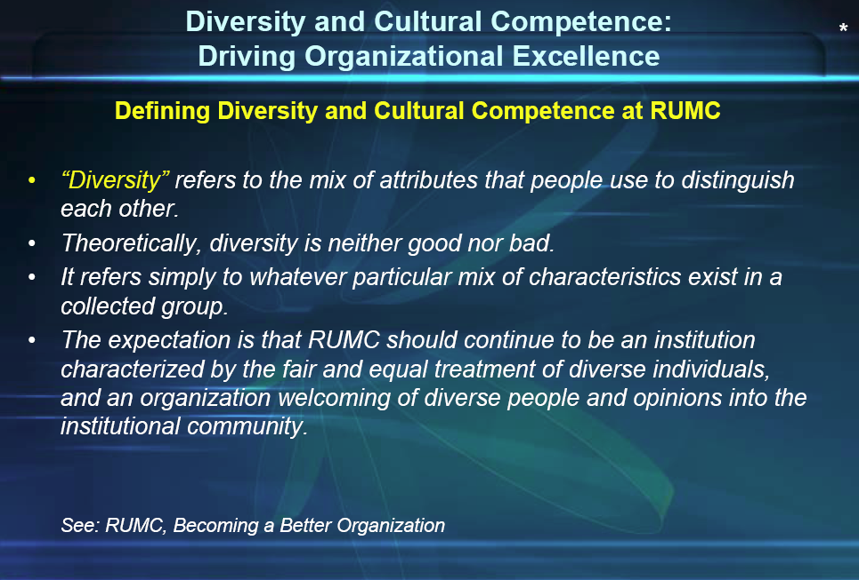

Slide 8
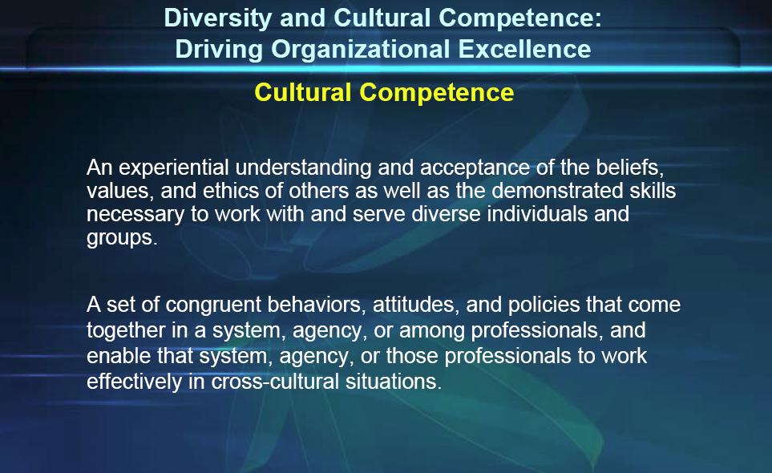

Slide 9
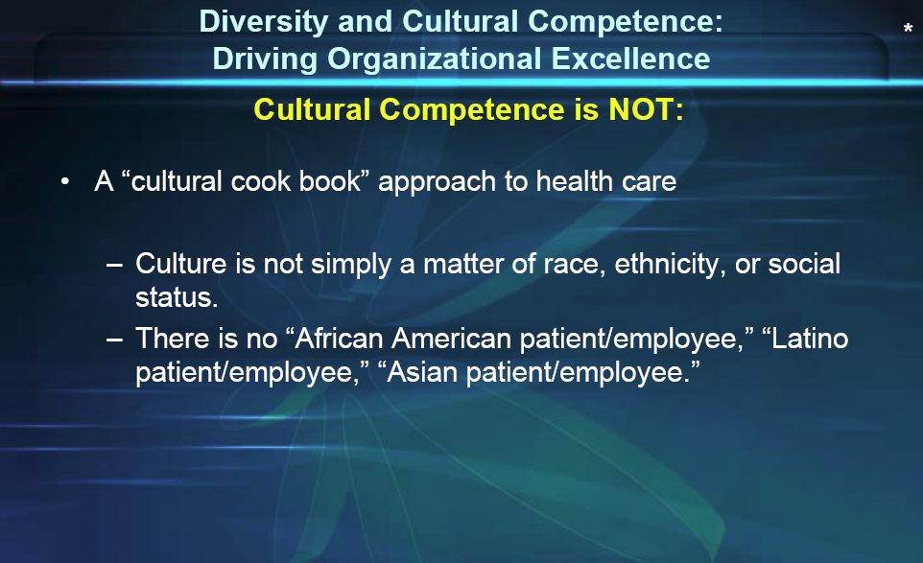

Slide 10
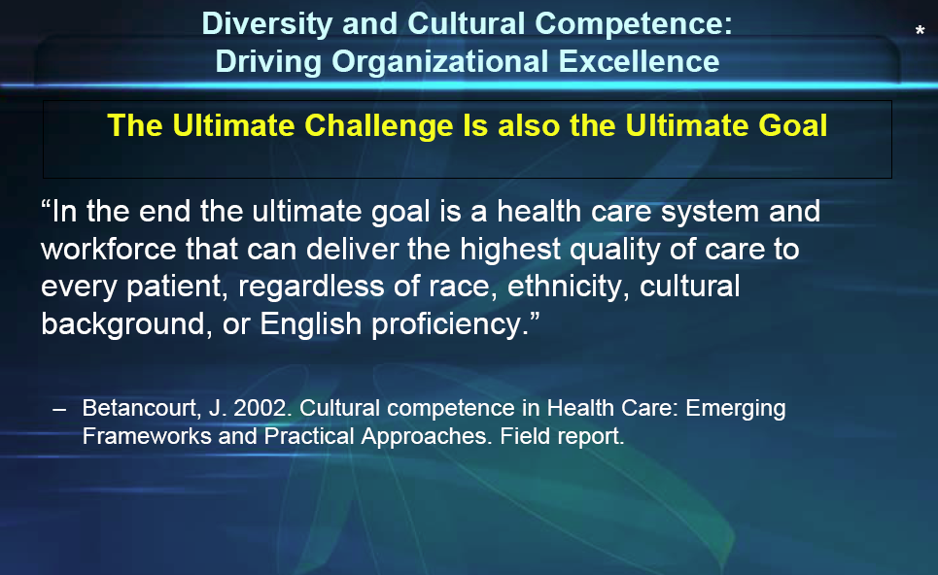

Slide 11
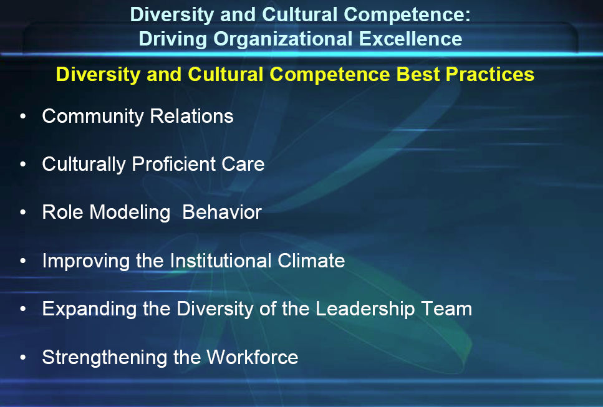

Slide 12
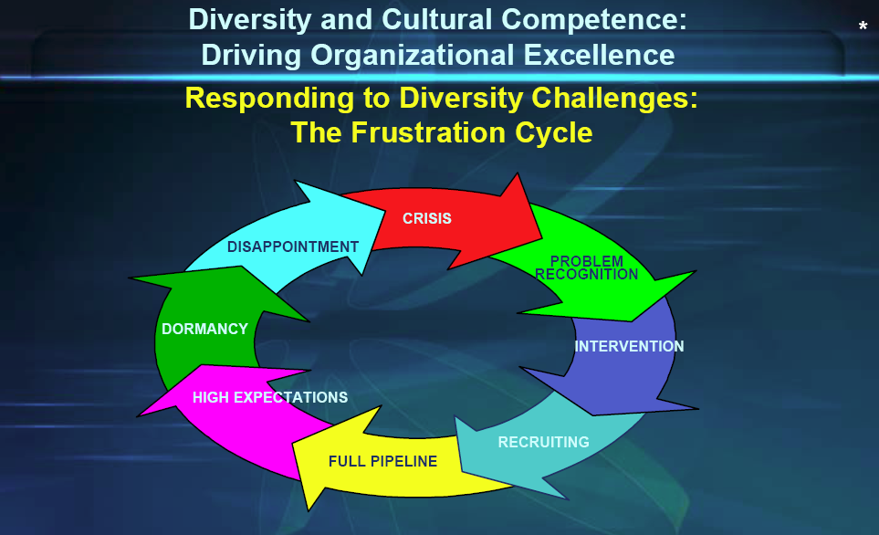

Slide 13
Executive Leadership Council
Diversity Leadership Council
Diversity and Inclusion at Rush
Charting the path 2012 – 2016
Key components:
Commitment
  Metrics
  Accountability
  Communication

Slide 14
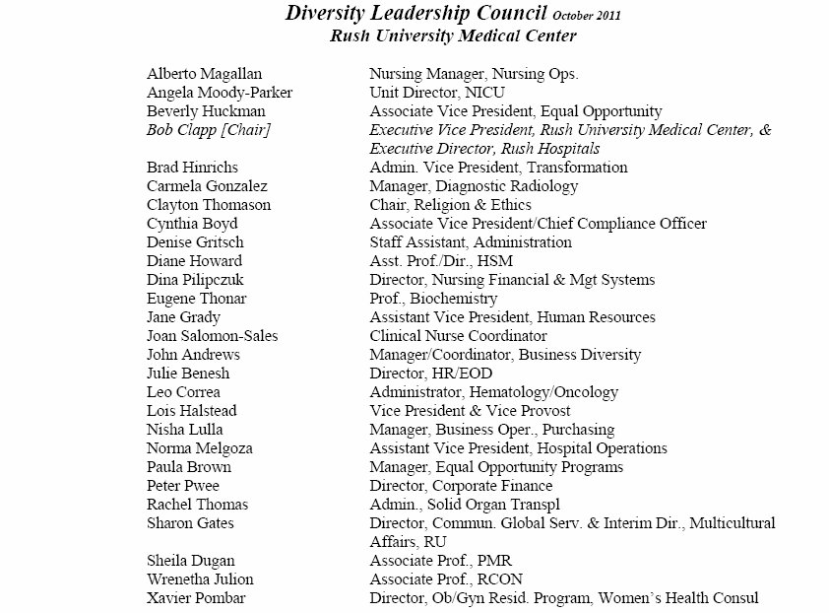

Slide 15
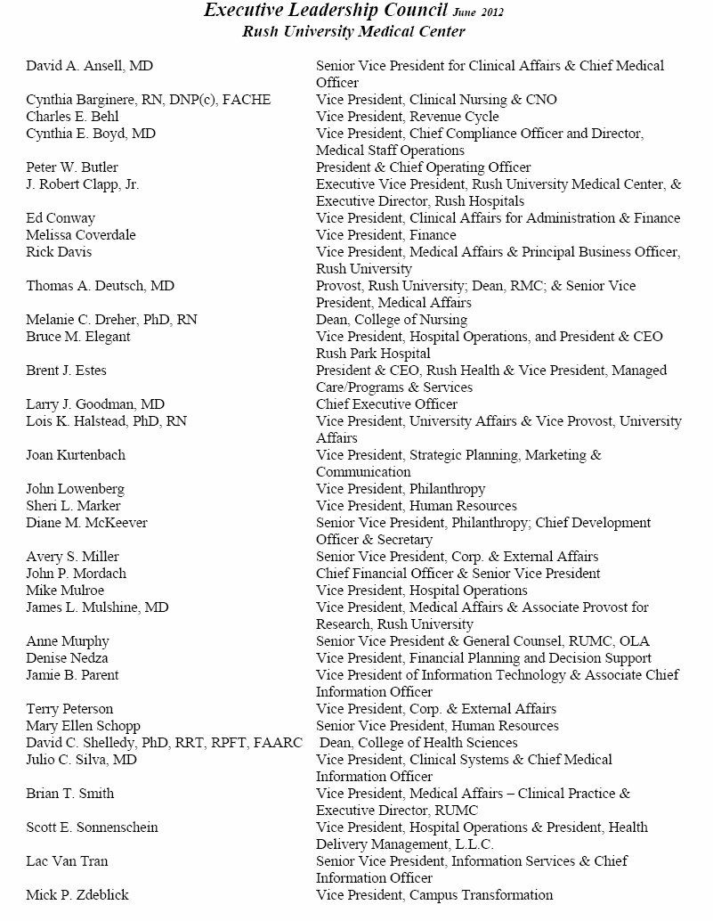

Slide 16
Rush Vision for Diversity &Inclusion
Rush University Medical Center will be a diverse and inclusive patient care, educational, research and community service institution of the highest caliber.
As evidenced by:
A commitment to diversity as a valued component of our organizational strategy.
A dedication to achieving a workforce, faculty, and student body that is reflective of the communities, patients and region we serve, and is demonstrated through the behaviors of the entire organization.
A culture of excellence that fosters an environment of equality and respect for those who work at Rush, those whom we care for, those whom we educate, those who benefit from the scientific advances we achieve, and those with whom we interact in our surrounding communities.

Slide 17
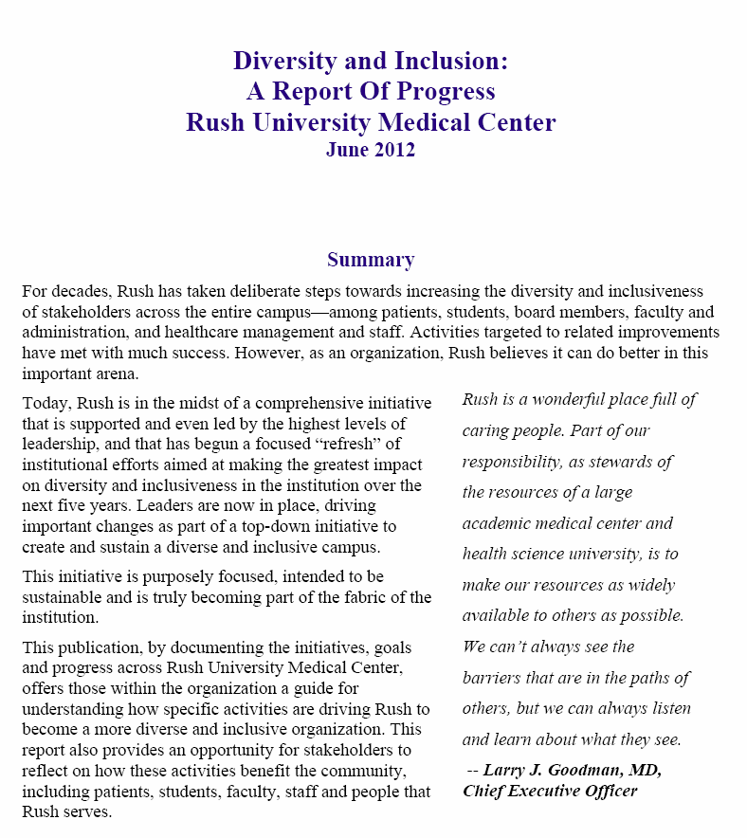

Slide 18
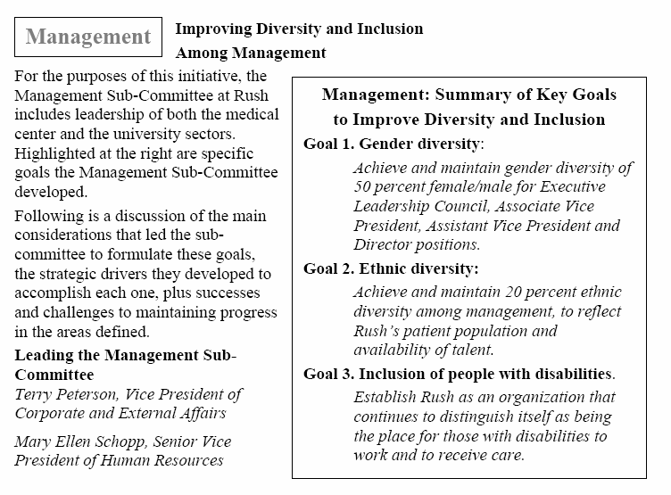

Slide 19
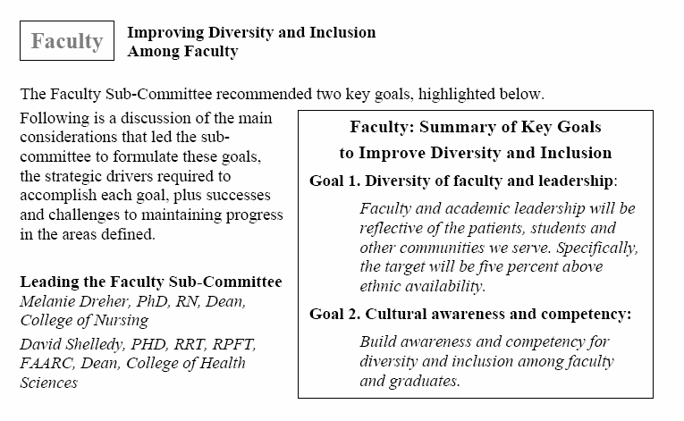

Slide 20
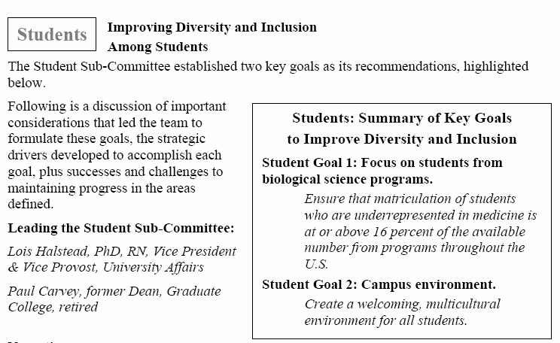

Slide 21
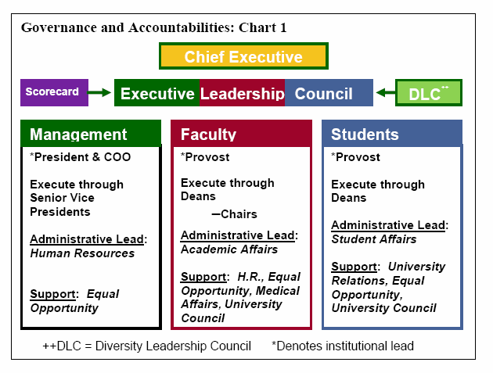

Slide 22


Cultural Competency and Engaging Communities
  understand the linguistic and cultural background of the community,
  promote cultural competency as an institutional priority,
  meet the needs of a diverse patient population.
Three representative examples at Rush:
    Interpreter Services: program and progress
        People with Disabilities: ADA Taskforce
            LGBT Community: Healthcare Equality Index

Slide 23
Cultural Competency and Engaging Communities
  understand the linguistic and cultural background of the community,
  promote cultural competency as an institutional priority,
  meet the needs of a diverse patient population.
    Interpreter Services
    program and progress

Slide 24
Interpreter Services
Past, Present, and Future
Rush University Medical Center

Slide 25
Interpreter Services Pre 2002
Prior to 2002 there were no centralized or formal interpretation services.
  Interpretation was facilitated by ad-hoc interpreters (bilingual staff or family members).
    Staff were pulled from normal duties
    Inefficient medium of interpretation
    Possibility of communication misunderstandings and errors, leading to patient safety issues

Slide 26
Rush Interpreter Services
Interpreter Task Force created in 2000
  24 multidisciplinary members
  Collaboration with other major medical centers
  Reviewed and updated Language Access Policies
  Conducted Needs Assessment
Findings and recommendations presented to Senior Leadership
  Approved the hiring of three Spanish Interpreters
  Centralized Language Services

Slide 27
Major Accomplishments
Year | Accomplishment
2002 | First Spanish interpreter hired
2003 | Reduced cost of over the phone interpretation by 75%
2005 | Rush Team of the Year Award
2006 | Expanded services to private physician offices and clinics on Rush’s campus
2007 | Introduced dual headset phone
2008 | Cadence Go Live – 90 clinics and hospital services First Polish interpreter hired
2009 | Translated patient’s menu to Spanish and Polish
2010 | Began providing services to Rush Oak Park Implemented internal line for medical center staff to directly access over- the-phone interpretation services Aided nursing in cultural competency portion of Magnet Award application

Slide 28
Interpreter Services Today
In-House Staff Spanish and Polish Interpreters
On-site interpretation
Dual headset phones
Internal line for staff to directly access over the phone interpretation
Conference calls with patients families
Written translation
Auxiliary aids for the hearing, vision and speech impaired

Slide 29
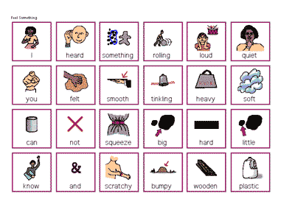
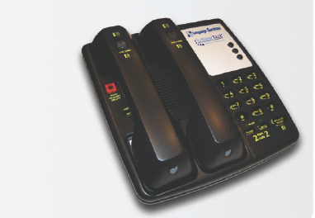
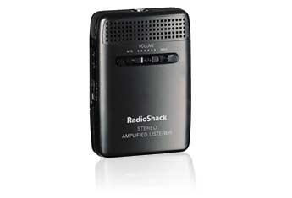


Interpreter Services Today
Auxiliary Aids
Speaker Phone
Sound Amplifier
Communication Board
TTY
Magnifier Reading Glass

Slide 30
Interpreter Services Today
Access to Agency Services
Access to on-site interpretation of 40 languages
Access to over 200 languages through over the phone interpretation
Top languages include:
  Spanish, Polish, Mandarin, Cantonese, Arabic, Russian, and American Sign Language

Slide 31
Interpreter Services Today
113,632
Requests for language services provided by Rush Interpreters in 2011

Slide 32
Interpreter Services Today
National Certification of all Staff Interpreters
  Certification Commission for Healthcare Interpreters (CCHI)
    Certified Healthcare Interpreter - CHI (Spanish)
    Associate Healthcare Interpreter – AHI (Polish)
First hospital in Illinois to have all interpreters certified at the highest level of certification
Notes:
By the interpreter service department’s 10 year anniversary, all Spanish interpreters will have a CHI credential and Polish interpreters will have an AHI credential, both of which are the highest possible certifications from the Certification Commission for Healthcare Interpreters (CCHI).
CCHI CREDENTIALS
CCHI has developed a credentialing program for healthcare interpreters. This program currently includes two credentials: Certified Healthcare Interpreter and Associate Healthcare Interpreter.
Certified Healthcare Interpreter (CHI).
A CHI has been tested on the most critical knowledge, skills and abilities required of a healthcare interpreter. A CHI must first complete the AHI examination, plus an oral performance examination testing the CHI’s interpreting skills and abilities in consecutive and simultaneous interpreting, sight translation and translation.
The CHI credential is currently only available for Spanish interpreters but is being developed in Arabic and Mandarin for launch in 2012. It will be developed for interpreters in other languages shortly.
Associate Healthcare Interpreter (AHI)
An AHI has been tested on only a part of the knowledge, skills and abilities that are required of a healthcare interpreter. The AHI examination tests interpreters on the most critical knowledge related to: managing an interpreting encounter; healthcare terminology; interacting with other healthcare professionals; preparing for an interpreting encounter; and cultural responsiveness.
Since the AHI examination does not test an individual’s actual interpreting skills and abilities, a certification is not awarded to those who pass this test. Rather, the AHI credential (a certificate indicating that the individual has passed the first step in becoming a CHI and has shown that he/she has the knowledge required of a certified healthcare interpreter) is available for all interpreters except those for whom the CHI examination is available in their language.

Slide 33
Improving the Patient Experience
Collaboration with Clinicians
  Charge nurse workshops
  Nursing competency training
  In-services in patient care areas
  Residency orientation
  Patient Special Services
Collaboration with Rush University
  Geriatric Interdisciplinary Team Training (GITT)
  Food & Nutritional Services Community Outreach
Crucial elements of the cultural competency portion of the Magnet Award application
Notes:
Residency orientation – educate residents on bridging the cultural and language barriers with patients.
PPS – collaborated with this department to form their own pool of Arabic interpreters.

Slide 34
Improving the Patient Experience
Translation of Wayfinding Signs
  Patients reviewed translations prior to posting
Multilingual information on Inter/Intranet
  Consent forms and Information sheets
  Health Information
  Patient Guide
  Events

Slide 35
The Future of Interpreting Services
Interpreter services will be expanding to video remote interpretation (VRI) services
  Provides almost instant access to interpreters
  Improves interpreter efficiency
  Allows staff interpreters to provide services to more limited English proficiency (LEP) patients

Slide 36






Interpreters at Rush
Spanish
Carlos Olvera
Ricardo Kirgan
Ana CamposAparicio
Lucia Flores
Rocio Rosiles
Debra Moughamian
Guadalupe García
Spanish cont.
Carolina Gómez
Mayra Navarrett
Cesar Mendoza
Iván Salvador
Polish
Pawel Smal

Slide 37
Cultural Competency and Engaging Communities
  understand the linguistic and cultural background of the community,
  promote cultural competency as an institutional priority,
  meet the needs of a diverse patient population.
        People with Disabilities
        ADA Taskforce

Slide 38
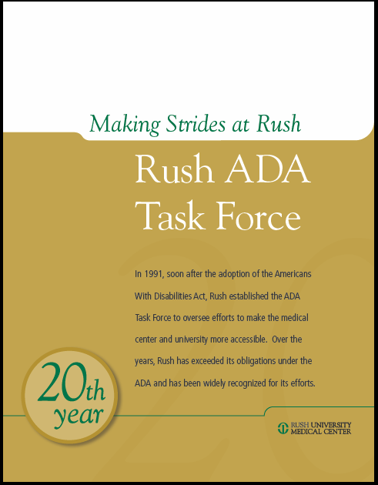

Slide 39
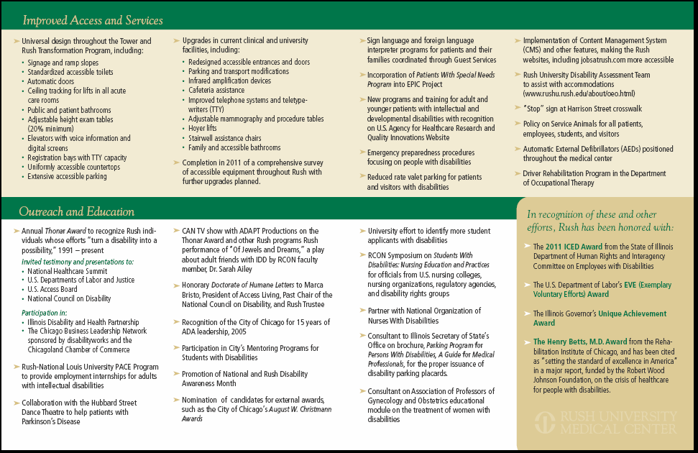

Slide 40
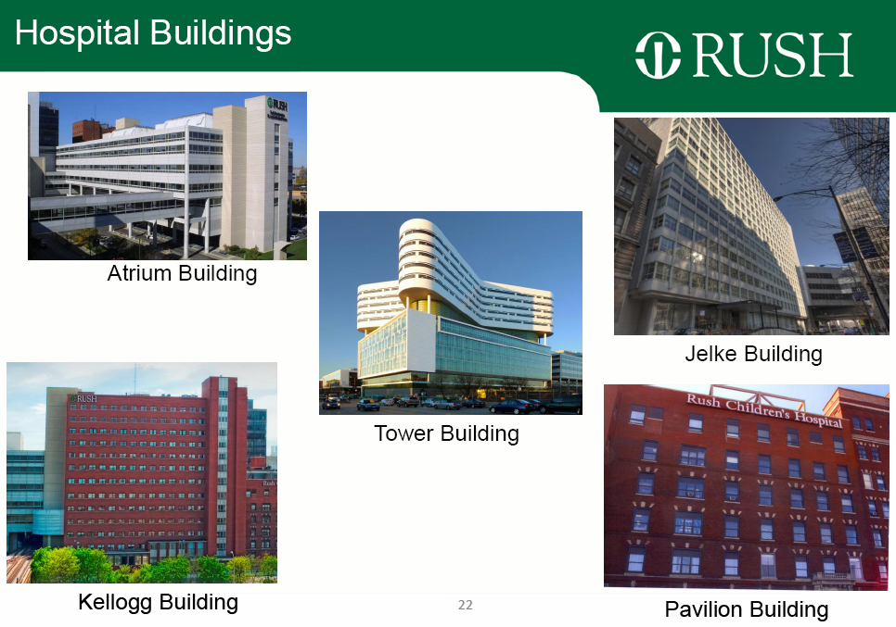

Slide 41
Select Universal Design Highlights
Principles of “Inclusive Design” or “Design for All” were key planning factors and were executed in the final facility.
Some examples include:
Fire Safety and Area of Refuge factors greatly expanded in Tower design and life-safety floor compartmentalization.
ADA requirements all achieved and extended in several categories.
Extensive handrails throughout facility and in patient rooms and bathrooms; all toilets at 18” above finished floor throughout; all acute care patient toilets have a 5’ diameter turning radius for wheelchairs
All sink and lavatory faucets have automatic sensors and temp. control
All major building entrances are accessible, sensor controlled, bi-parting automatic sliding doors: all users enter equally.
All patient rooms have built-in ceiling tracks for patient lift devices.
Furniture and casework were chosen to accommodate all regardless of mobility or size.
Floor coverings, color palettes, elevator controls, and wayfinding signage were chosen to better serve those with visual or other sensory challenges.

Slide 42
Cultural Competency and Engaging Communities
  understand the linguistic and cultural background of the community,
  promote cultural competency as an institutional priority,
  meet the needs of a diverse patient population.
    LGBT Community
    Healthcare Equality Index

Slide 43

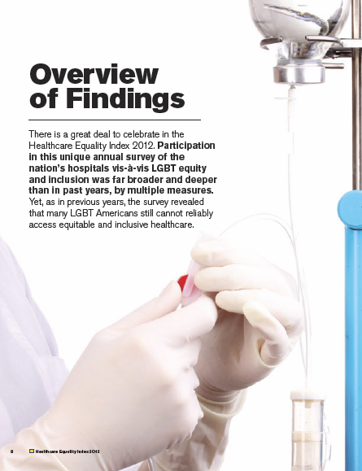

Slide 44

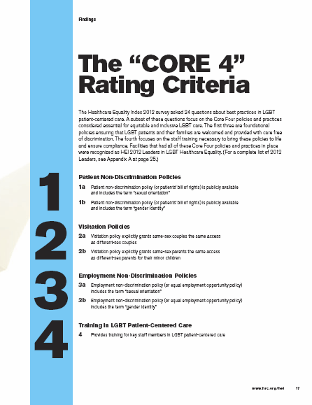

Slide 45
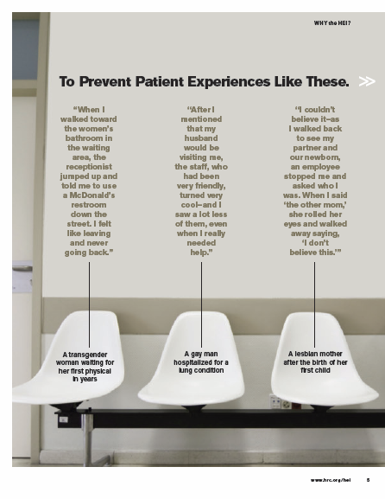

Slide 46
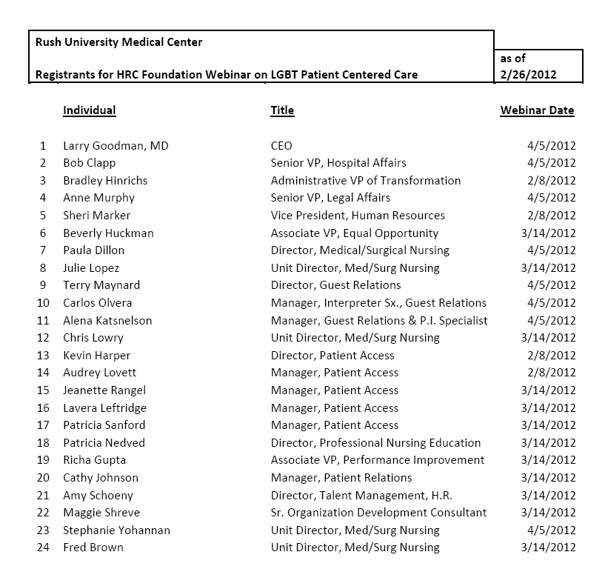

Slide 47
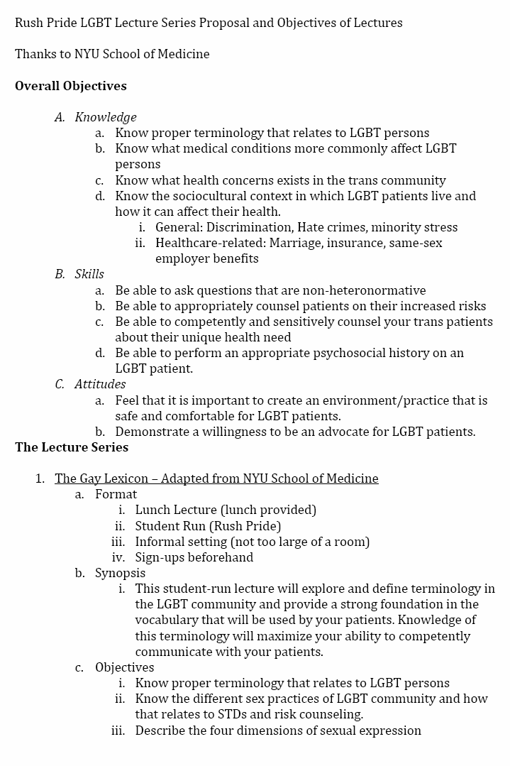
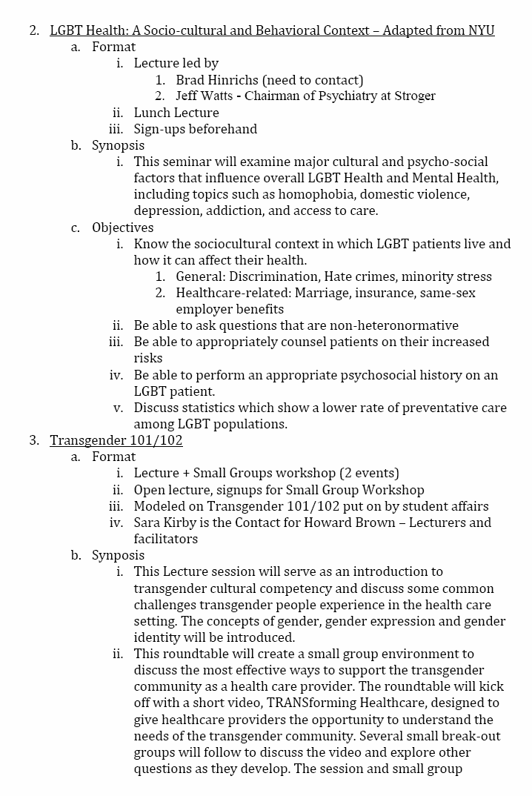

Slide 48
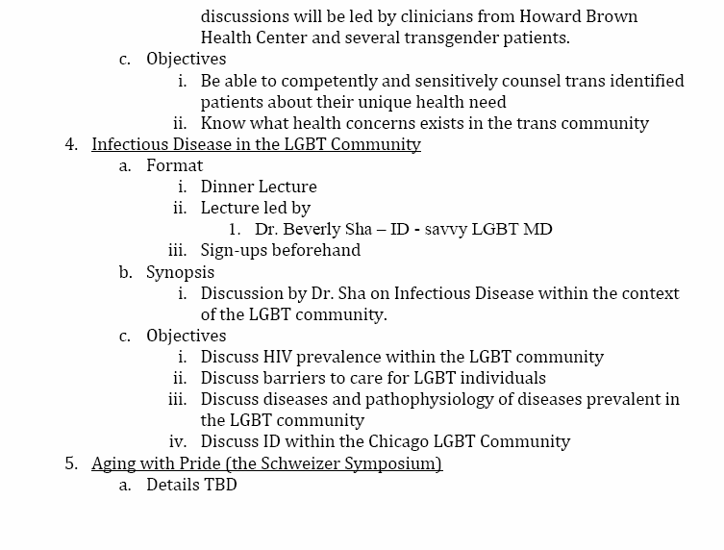

Slide 49


Slide 50
Diversity and Inclusion
A Journey: Compliance to Commitment

Slide 51
WHO ARE WE?
A private, nonprofit organization
Indiana University Health (IU Health) is Indiana’s largest comprehensive health system and is comprised of hospitals, physicians and allied services dedicated to providing preeminent care throughout Indiana and beyond
Our unique partnership with the Indiana University School of Medicine gives our highly skilled physicians access to innovative treatments using the latest research and technology
IU Health was recently named to the exclusive U.S. News & World Report 23rd annual Best Hospitals ‘Honor Roll’ – one of 17 preeminent medical centers across the nation that have the highest skill and unparalleled capacity to handle the most challenging medical cases
IU Health is Indiana’s largest employer, with 26,000 employees, and is dedicated to supporting the local communities it works in

Slide 52
PATIENT FACTOIDS
While Spanish remains the number one interpretation need, in 2010 interpretation in 62 languages/dialects were requested
To meet the increasing demand, 7 additional Spanish interpreters were hired in July bringing the total to 35
In 2011, we average 4,800 encounters per month and 479 monthly calls to the toll-free interpretation line
IU Health Chaplaincy staff is representative of all races and all major religions
Inpatient Population
  White 71%
  Black 22%
  Hispanic 4%
  Two or More 2%

Slide 53
WHO ARE WE?
The Diversity & Inclusion department is responsible for designing and implementing diversity, inclusion, and talent management programs that meet IU Health’s goals and vision for workforce diversity
Notes:
53
We are going to cover the listed topics today.
Before we continue our presentation, just a few quick items:
Note that the nearest restrooms are (give directions).
Please put all cell phones and pagers on vibrate, we want your full attention!
We are a smoke-free environment; smoking is prohibited on IU Health campuses.

Slide 54
THE BIG PICTURE
How we define diversity and inclusion:
Diversity with a little d - differences in gender, race, nationality, ethnic background, etc
Diversity with a big D – broader concept that includes other critical attributes, such as ways of thinking, culture, generations, religion, customs, etc
Inclusion – understanding, embracing and leveraging Diversity to drive the IU Health mission
Embracing Diversity enables preeminent care

Slide 55
FOCUS AREAS
Clinical – Providing culturally sensitive personalized care, including mind, body & spirit, for all cultures
Workforce – Being an Employer of Choice that attracts, retains & develops a highly qualified workforce that mirrors the demographics of the community we serve
Business – Supporting a level playing field & promoting good financial stewardship by using a wider pool of qualified & cost-competitive certified minority/women/veteran enterprises for goods & services
Community – Nurturing a community that understands, includes & embraces healthy Diversity
Leadership – Being culturally competent leaders who understand, include & embrace Diversity & lead others in doing so to improve the health of our patients & community

Slide 56

PEOPLE PILLAR GOAL
The People Pillar Goal for Diversity was established in 2009 as a goal that cascaded to specific entity goals for the purpose of reducing underutilization in professional job groups over a 3 to 5 year period
2010
Exceeded our goal by more than 33%
2011
Increase diverse employee population by 1% focusing on recruitment and retention
Exceeded our goal by more than 100%
2012
Expand People Pillar Goal to include additional lU Health locations
Notes:
56
We are going to cover the listed topics today.
Before we continue our presentation, just a few quick items:
Note that the nearest restrooms are (give directions).
Please put all cell phones and pagers on vibrate, we want your full attention!
We are a smoke-free environment; smoking is prohibited on IU Health campuses.

Slide 57
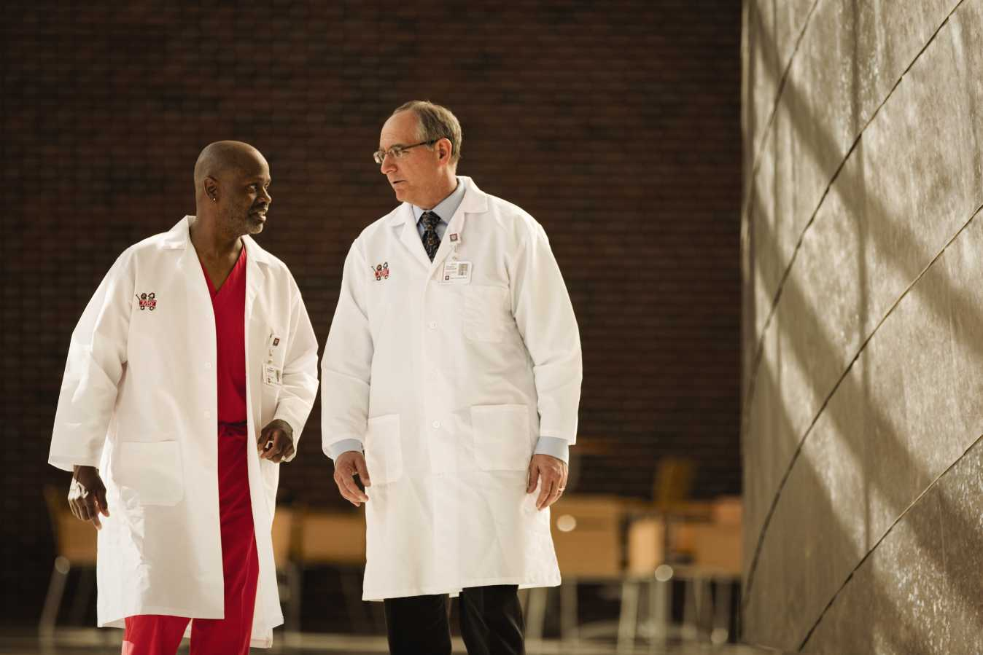
ACHIEVEMENTS
2011
Recipient of 40th Anniversary Award from National Black Nurses Association for minority nursing outreach
Recognized Champion of Diversity by the Indiana Minority Business Magazine
2010
Received Distinguished Community Service Award from the Black Nurses Association of Indianapolis
Nationally recognized for Diversity practices by the Institute for Diversity in Health Management for Best In Class – Strengthening a Diverse Workforce
Recognized as a Top Work Place by The Indianapolis Star and Workplace Dynamics
Notes:
57
We are going to cover the listed topics today.
Before we continue our presentation, just a few quick items:
Note that the nearest restrooms are (give directions).
Please put all cell phones and pagers on vibrate, we want your full attention!
We are a smoke-free environment; smoking is prohibited on IU Health campuses.

Slide 58

PROFESSIONAL RECRUITMENT OUTREACH EVENTS & PARTNERSHIPS
Evening with IU Health
Connect degreed, skilled trade and licensed professionals with viable IU Health employment opportunities
Introduce top minority talent to senior leadership, hiring managers and directors
Enhance goodwill in the community
87% retention rate for hires after 18 months
Strengthening Our Pipeline
Introduced twenty (20) youth, civic, schools and placement organizations to IU Health
A three pronged approach aimed to:
  Introduce youth leaders from Boys and Girls Clubs,
Community Centers, Guidance Counselors, and church organizations to IU Health mission critical positions
  Provide information on what IU Health looks for in professionals
  Reintroduce our organization through our new branding efforts
Notes:
58
We are going to cover the listed topics today.
Before we continue our presentation, just a few quick items:
Note that the nearest restrooms are (give directions).
Please put all cell phones and pagers on vibrate, we want your full attention!
We are a smoke-free environment; smoking is prohibited on IU Health campuses.

Slide 59
PROFESSIONAL RECRUITMENT OUTREACH EVENTS & PARTNERSHIPS
Earned Income Tax Credit
Free tax return preparation to eligible employees providing an alternative to predatory income tax preparation
Professional employees volunteer their time to learn about tax preparation and share that knowledge with fellow employees who meet Earned Income Tax Credit eligibility standards
The Benefits and Diversity & Inclusion departments partner with the Internal Revenue Service and the Financial Health Federal Credit Union to provide this service to employees
Community Partners
Relationships with 25 local organizations that offer computer access and application assistance to IU Health applicants
Since 2007, more than 300 candidates have been hired
Notes:
59
We are going to cover the listed topics today.
Before we continue our presentation, just a few quick items:
Note that the nearest restrooms are (give directions).
Please put all cell phones and pagers on vibrate, we want your full attention!
We are a smoke-free environment; smoking is prohibited on IU Health campuses.

Slide 60
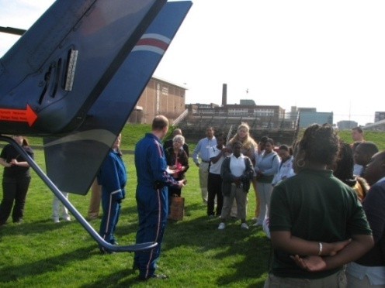
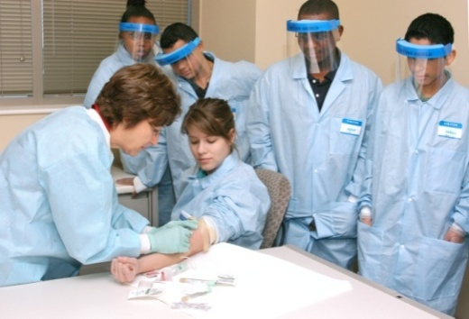
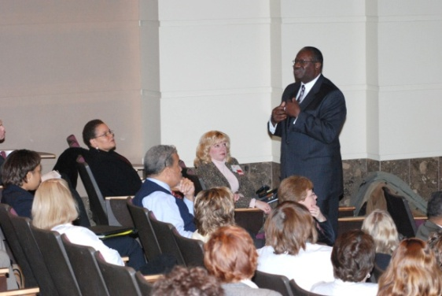
PROFESSIONAL RECRUITMENT OUTREACH EVENTS & PARTNERSHIPS
Say Ahh!
A school-based program to expose middle to high school students to the critical-need healthcare jobs and the education and training they will need to pursue these careers
More than 325 students from IPS and township schools participate each year
Started with AHC (downtown hospitals and has expanded to additional facilities
Facilitated by HR staff
Annual Martin L. King, Jr. Celebration
Program expanded to include IU Health statewide entities via video conference
Patients have the option to view the program on television in their rooms
IU Health Methodist Hospital hosts
There were more than 650 statewide attendees in 2012
Notes:
60
We are going to cover the listed topics today.
Before we continue our presentation, just a few quick items:
Note that the nearest restrooms are (give directions).
Please put all cell phones and pagers on vibrate, we want your full attention!
We are a smoke-free environment; smoking is prohibited on IU Health campuses.

Slide 61

PROFESSIONAL RECRUITMENT OUTREACH EVENTS & PARTNERSHIPS
Exploring Nursing
A variety of hands-on activities, hospital tours, and shadowing events to attract junior and high school students to Nursing
Program continues to be a success with four (4) participants of the program completing college and joining IU Health in 2010
We have hired 12 program participants since its inception in 2003
The program is provided in collaboration with the Boy Scouts of America Council
Gift of Care Giving
An opportunity for employees statewide to refocus and refresh themselves for two days and recommit to the IU Health mission, vision and values
More than 350 employees have participated in the program since its inception in 2009
Notes:
61
We are going to cover the listed topics today.
Before we continue our presentation, just a few quick items:
Note that the nearest restrooms are (give directions).
Please put all cell phones and pagers on vibrate, we want your full attention!
We are a smoke-free environment; smoking is prohibited on IU Health campuses.

Slide 62
PROFESSIONAL RECRUITMENT OUTREACH EVENTS & PARTNERSHIPS
Other Outreach Initiatives:
Crispus Attucks Medical Magnet High School
Phillipine and Black Nurses Professional Associations
Building relationships with Historically Black Colleges and Universities to attract more minority Pharmacy and Nursing graduates
Annually nominate an employee for the Center for Leadership Development Minority Achiever’s Award; 4 IU Health professionals recognized in the last 5 years
Affinity Groups to engage and assist in the development and retention of females and minorities:
    Women’s Managers and above Affinity Group
    Minority Manager and above Affinity Group
    GLBTA Affinity Group
    Minority Nursing Task Force
Notes:
62
We are going to cover the listed topics today.
Before we continue our presentation, just a few quick items:
Note that the nearest restrooms are (give directions).
Please put all cell phones and pagers on vibrate, we want your full attention!
We are a smoke-free environment; smoking is prohibited on IU Health campuses.

Slide 63
Our Journey to Inclusion

